Slide 1
R.I.C
The Robotic Interactive Companion

Slide 2
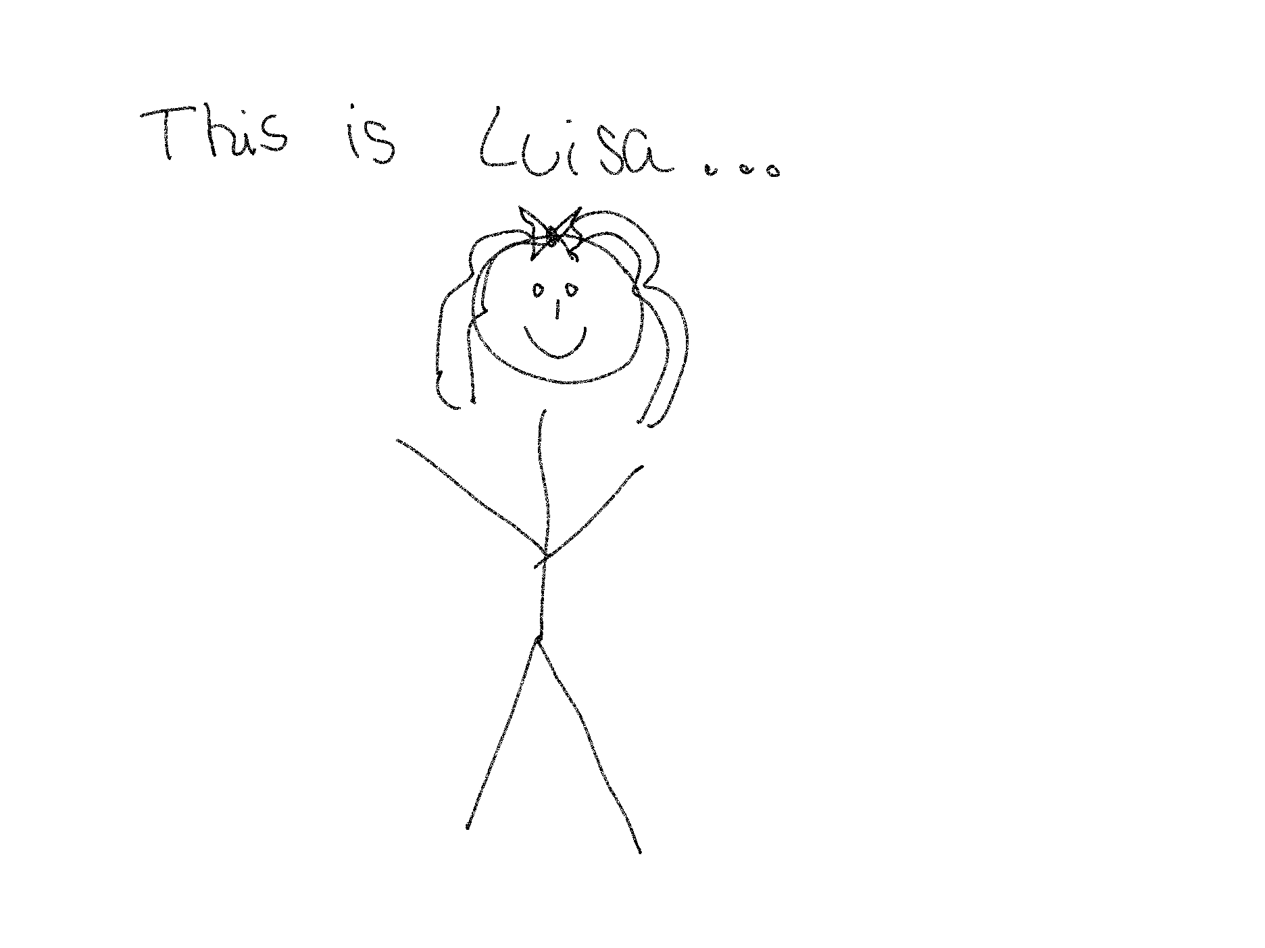
Notes:
This is Luisa

Slide 3
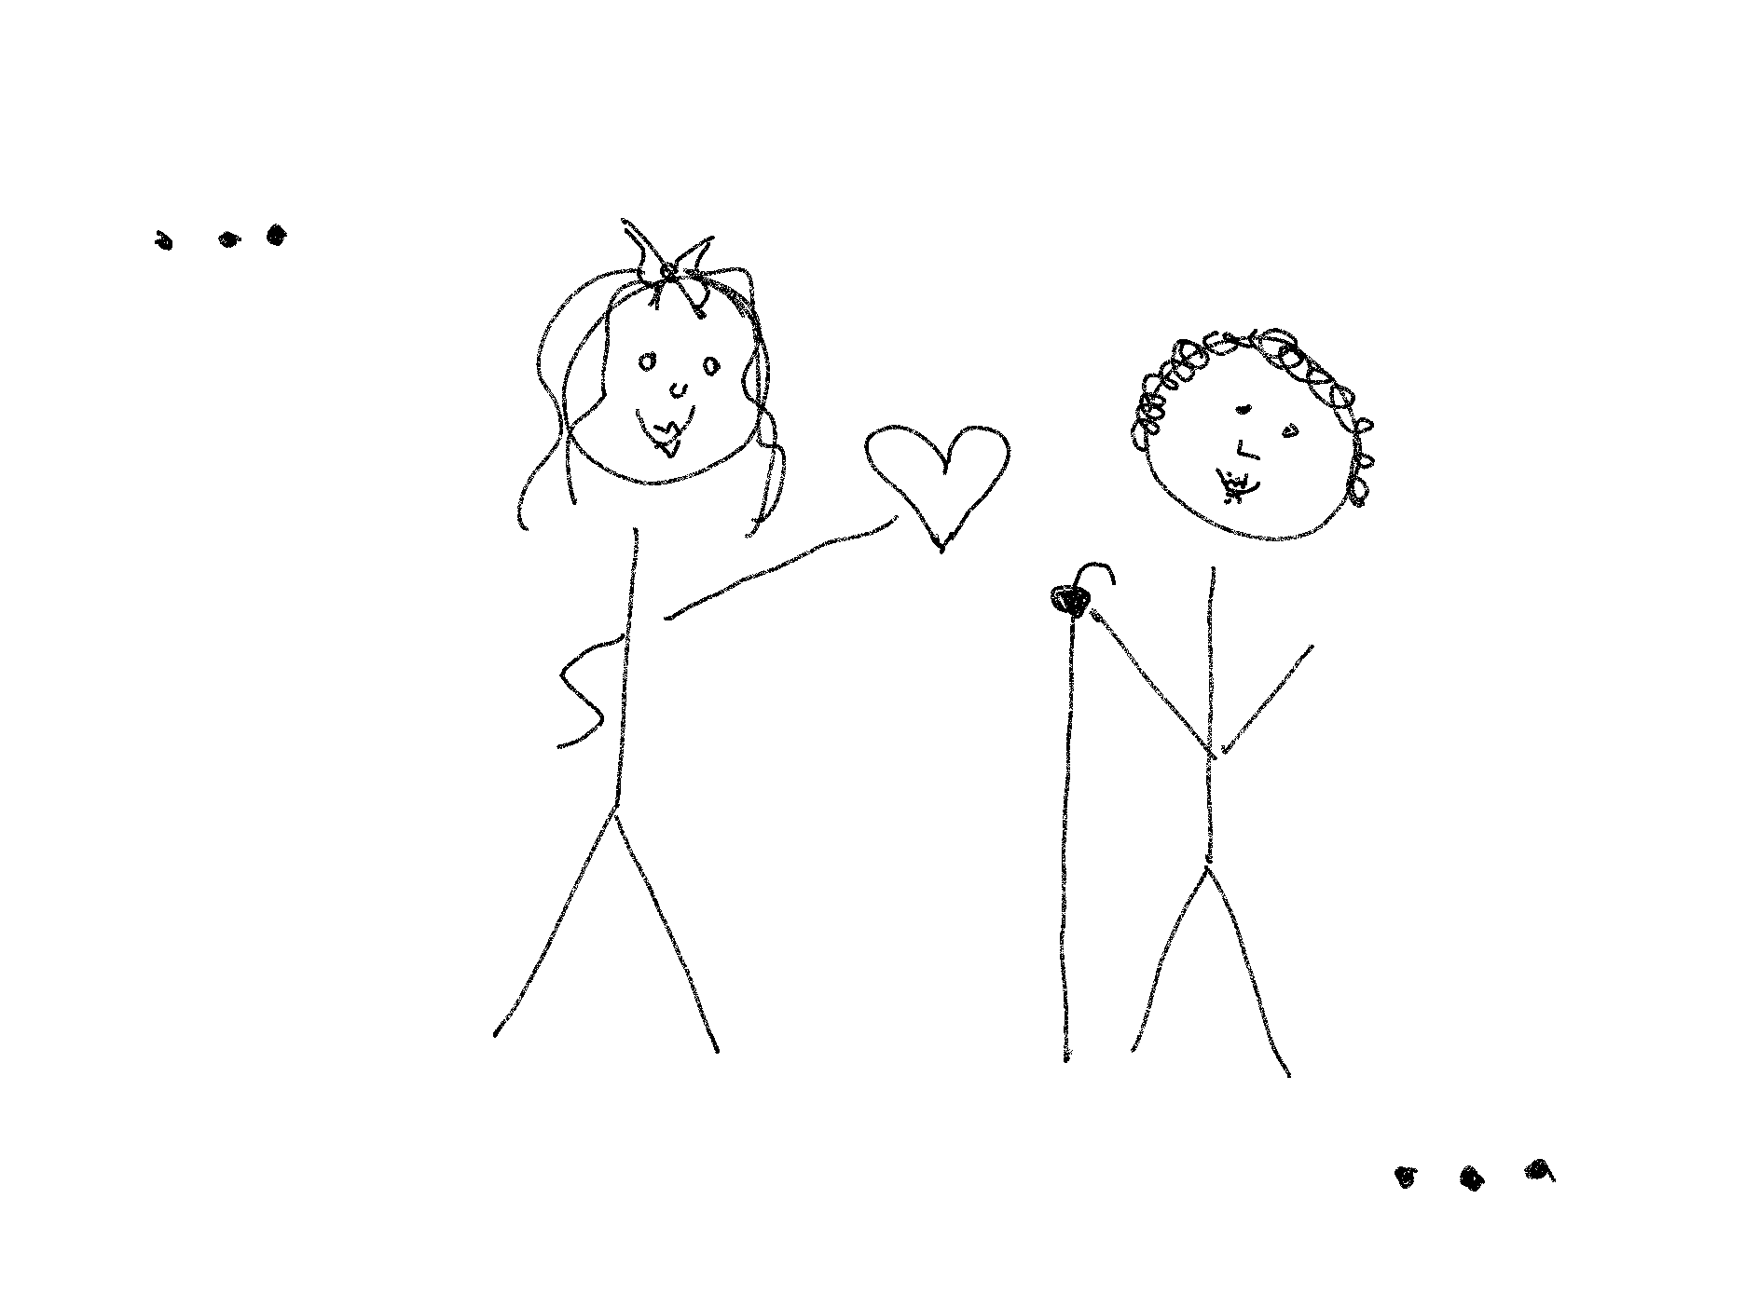
Notes:
Luisa loves her grandma

Slide 4
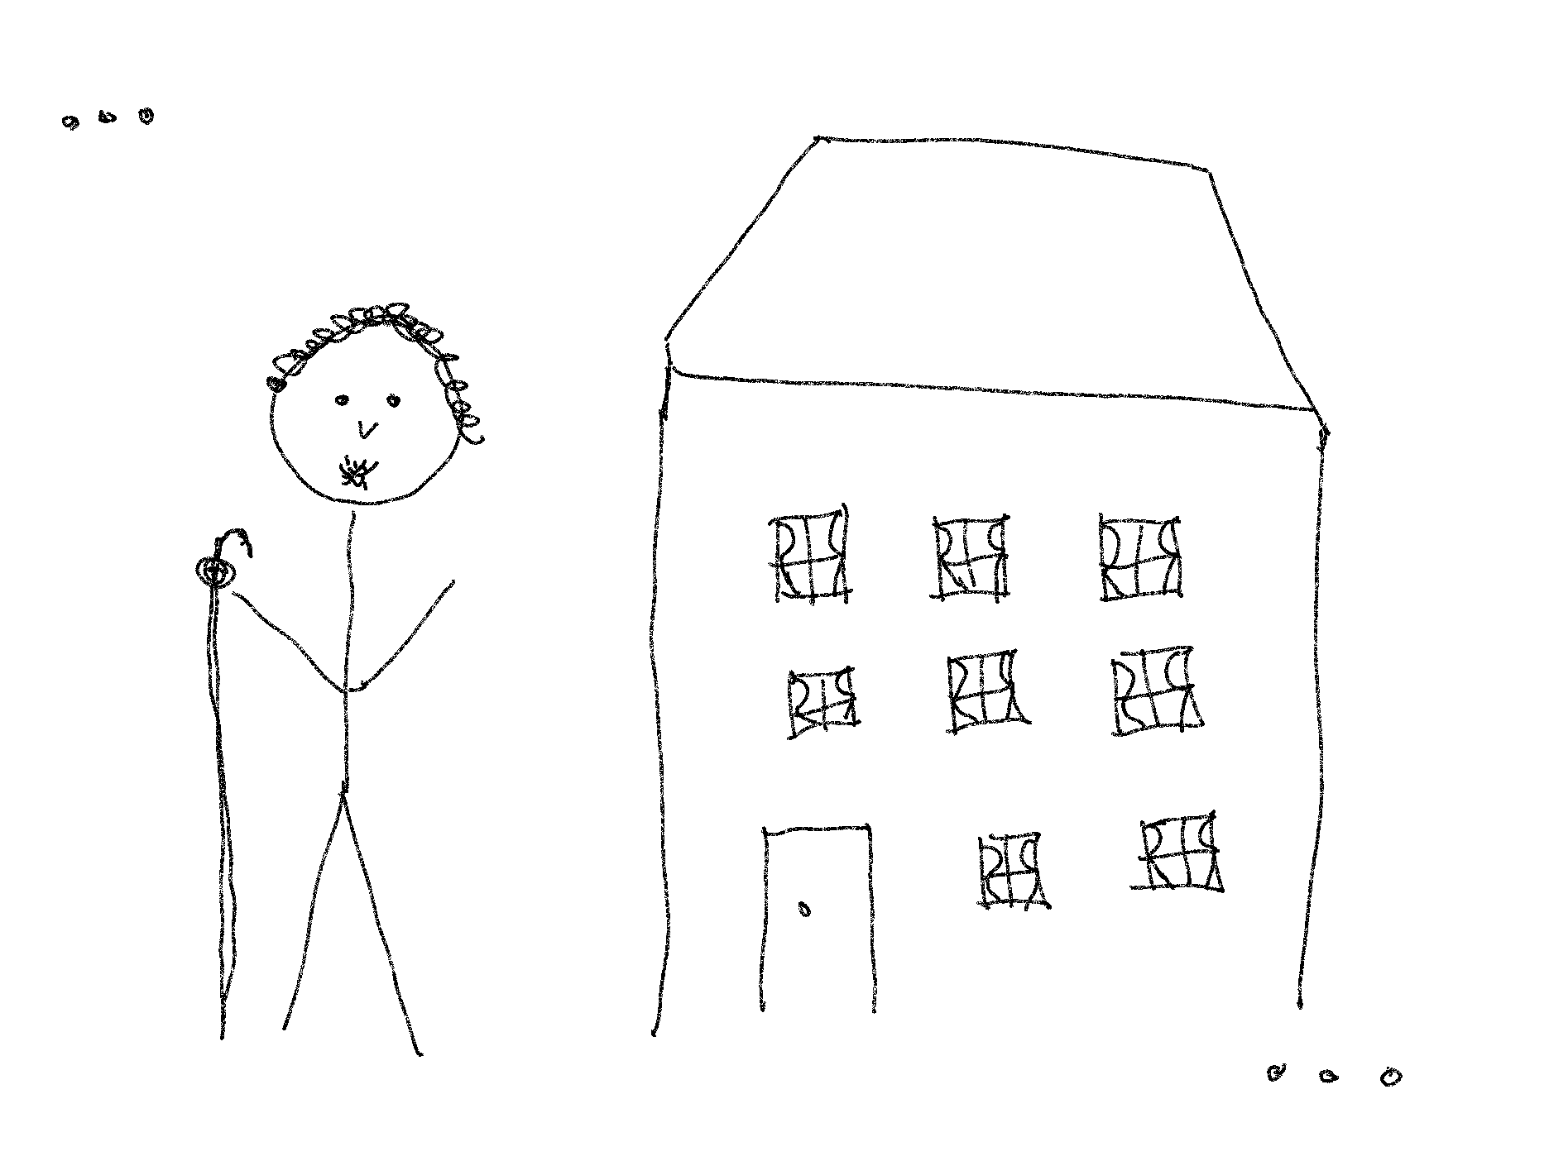
Notes:
But grandma lives far away in a home for
elderly people

Slide 5
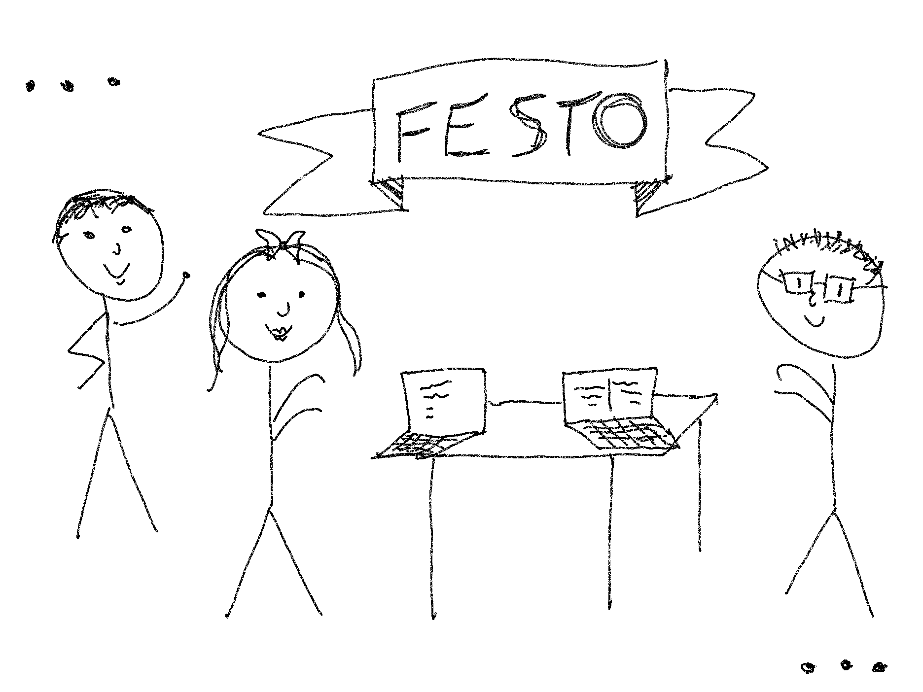
Notes:
And Luisa has not much time to visit her because
she is at hackathons every weekend

Slide 6
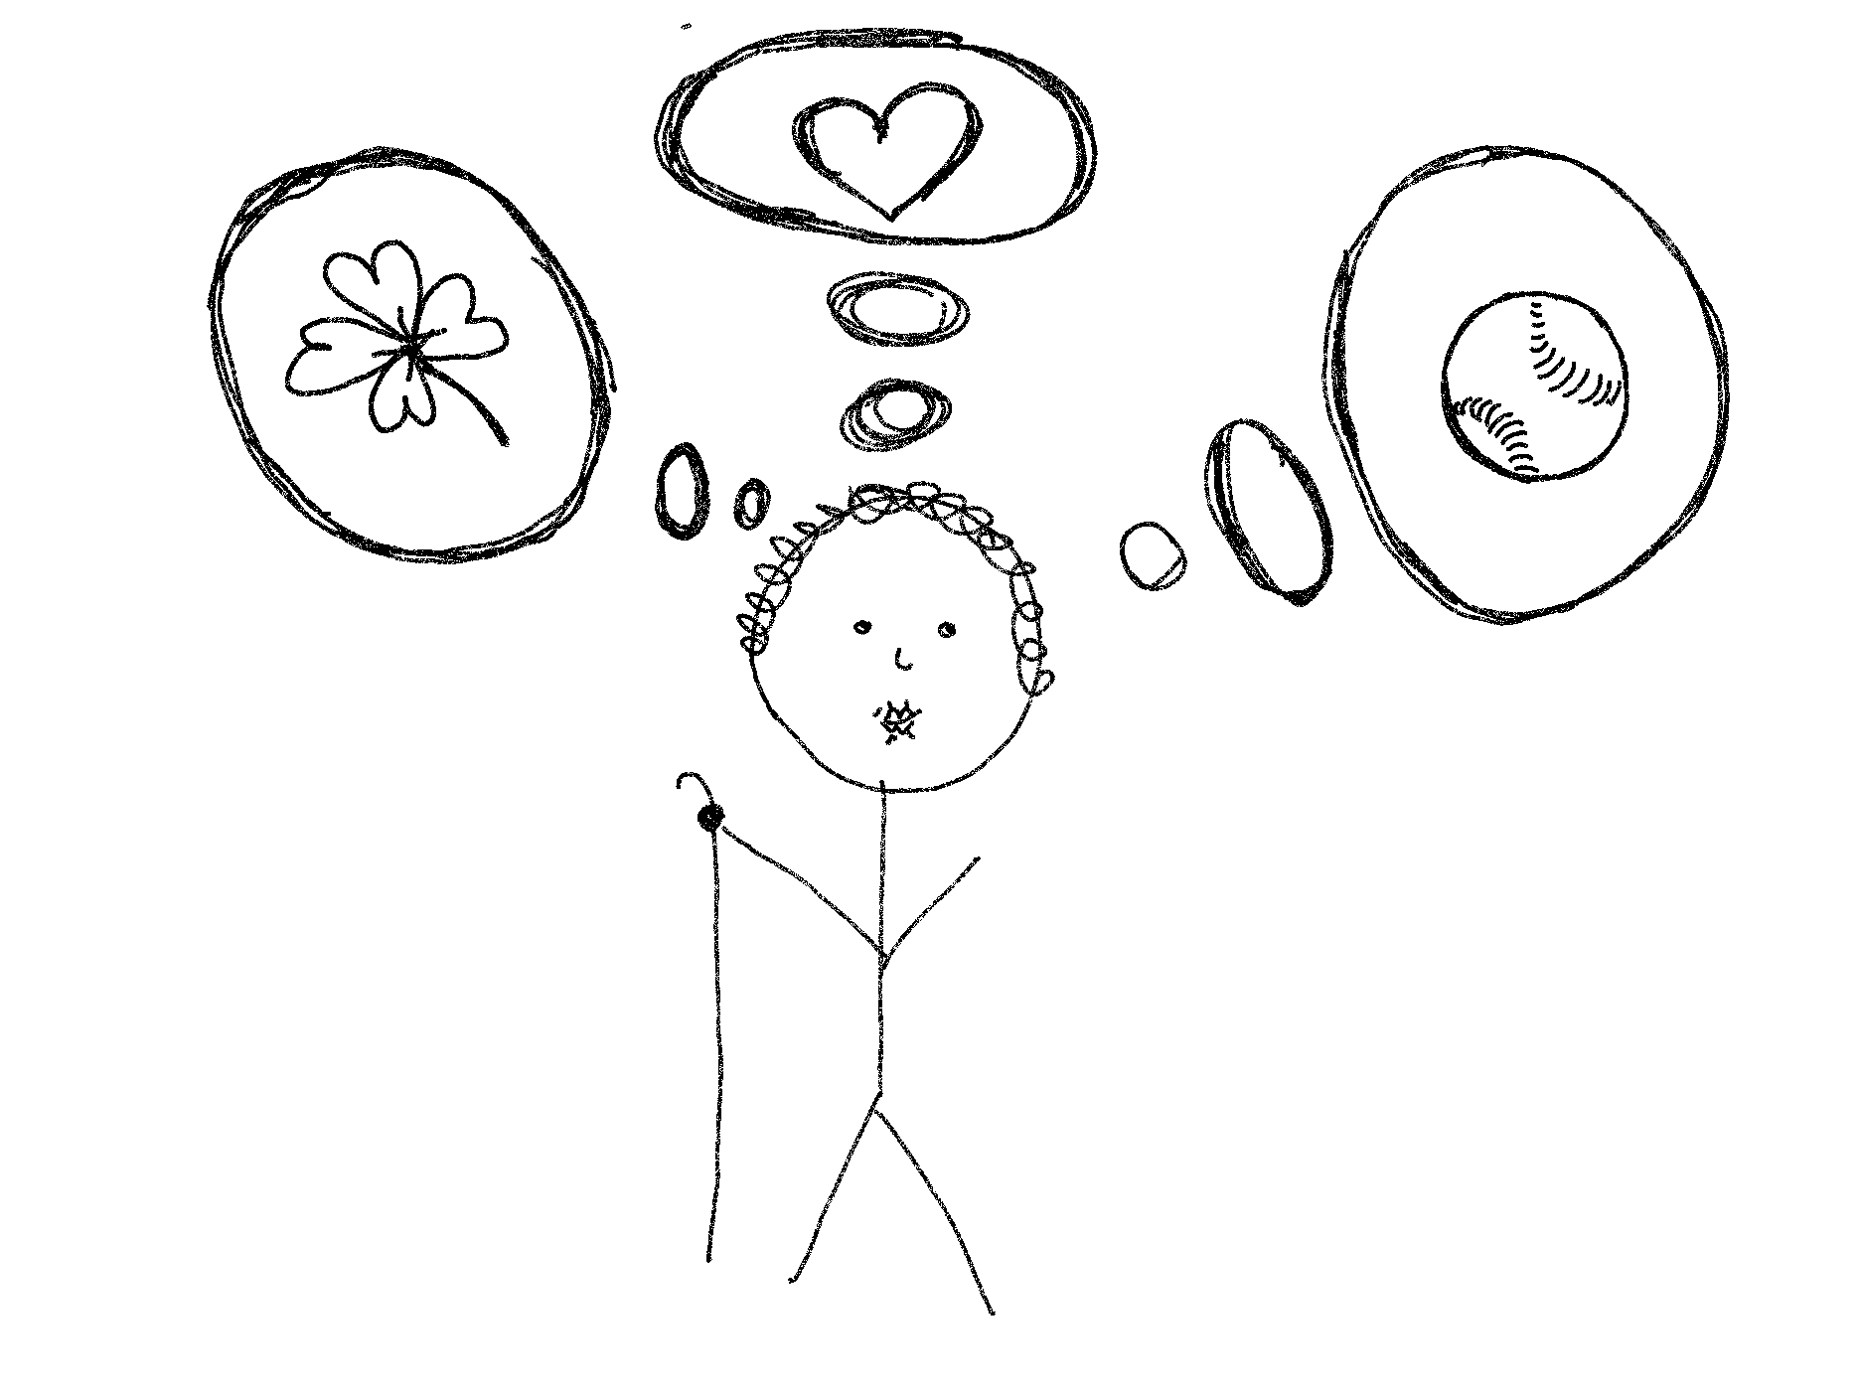
Notes:
So grandma is bored.
She wants to have fun,
she wants to be loved
and she needs exercise

Slide 7
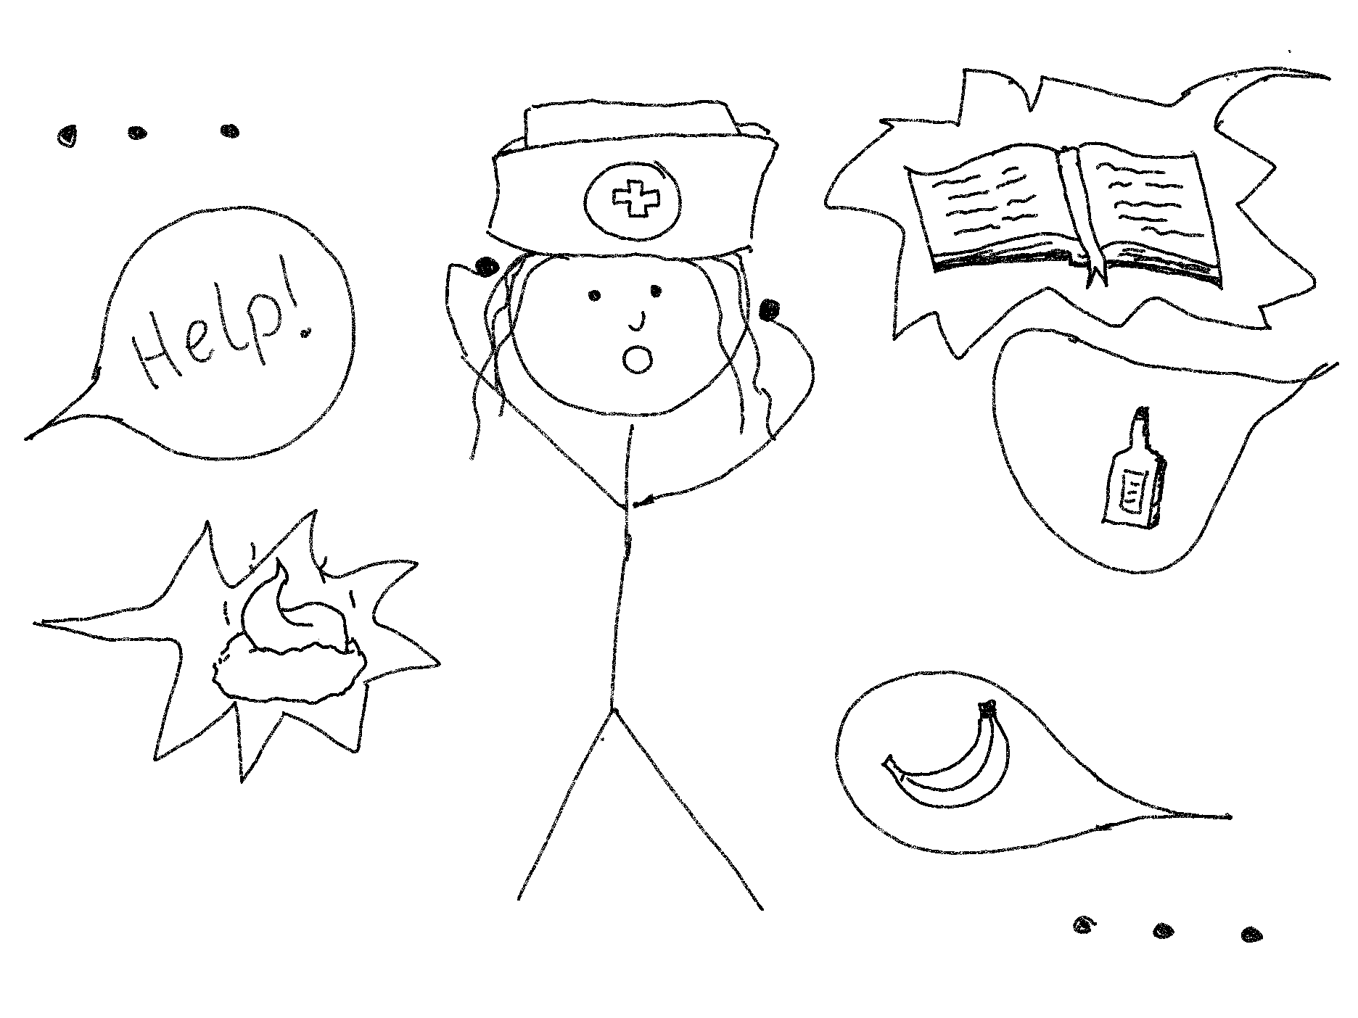
Notes:
But:
The nurses can not entertain her

Slide 8

Notes:
They don’t have time
They don’t have money
And there are not enough people to do all the work

Slide 9
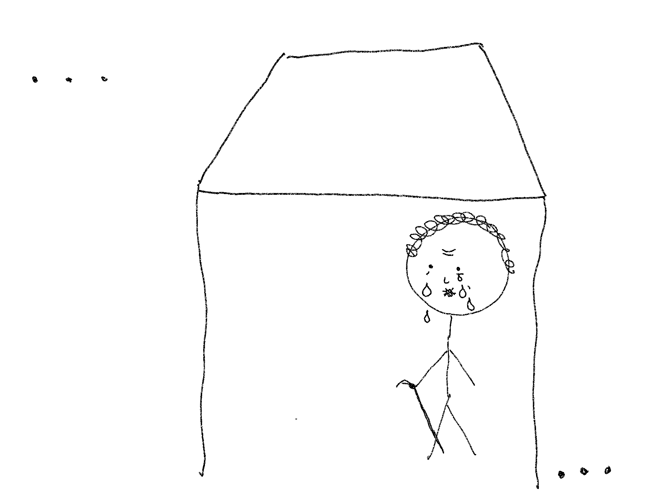
Notes:
So grandma is very sad and alone everyday

Slide 10
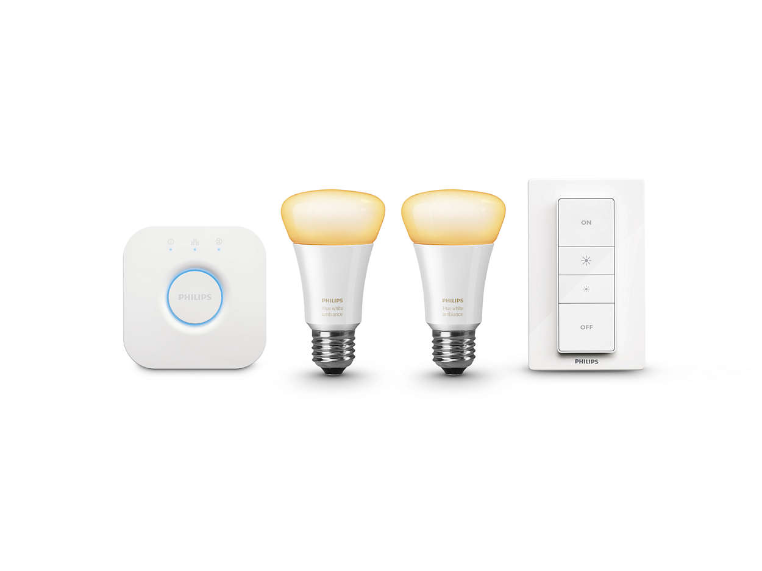
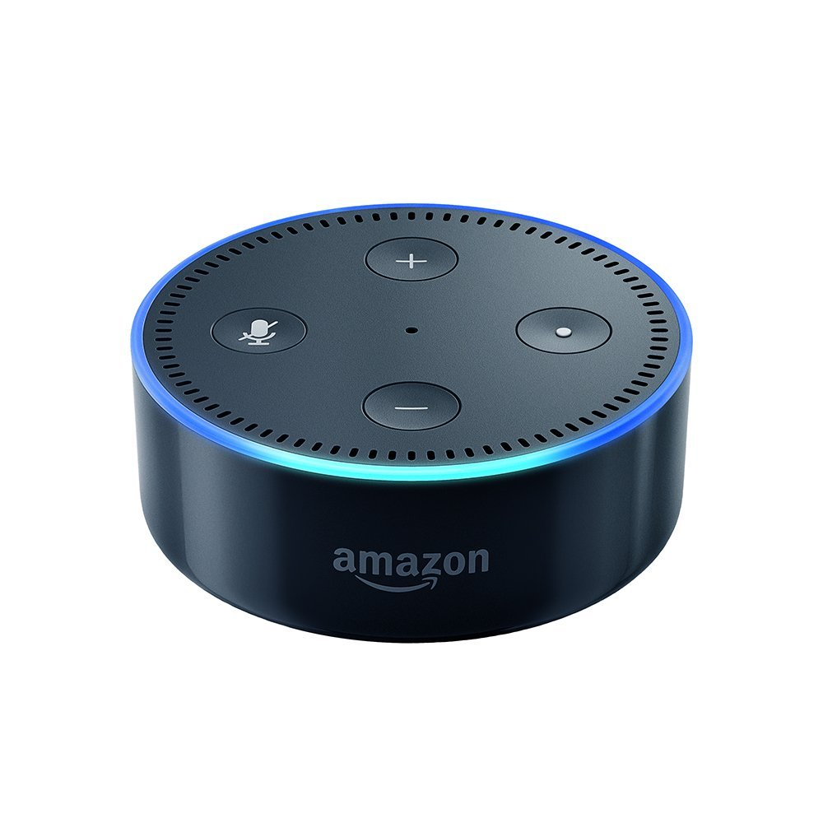
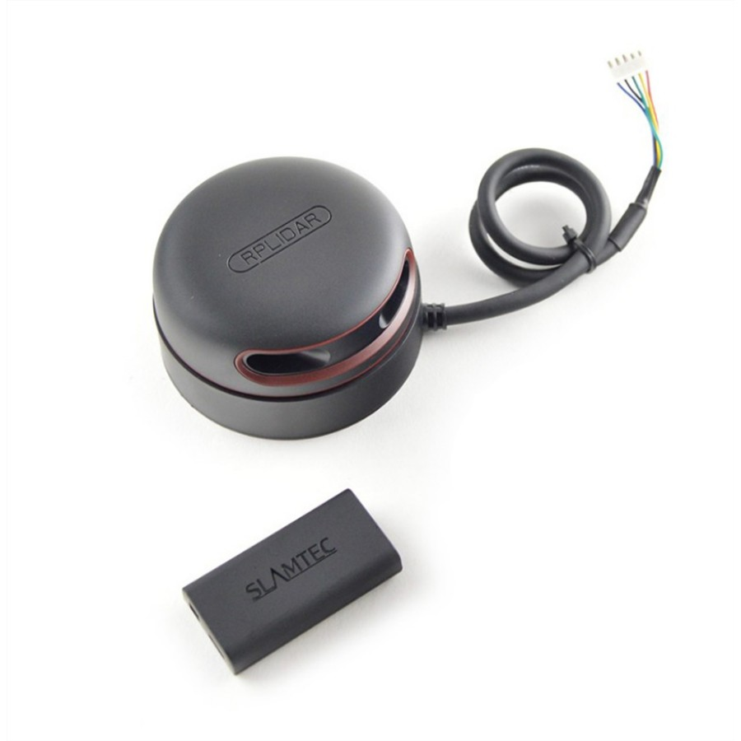
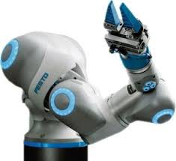
Philips Hue
visual interface
Amazon Alexa
natural speech interface
Festo BionicCobot
physical interaction
RPLIDAR
motion tracking
Notes:
We thought: It doesn’t have to be that way!
We combined the latest technology to solve this problem of our society
We use Amazon Alexa as a natural speech interface
Philips Hue as a visual interface
RPLIDAR for additional motion tracking
And the Festo BionicCobot for physical interaction

Slide 11



https://www.istockphoto.com/ch/foto/young-woman-boxing-training-with-sparring-partner-gm619543854-108075803
Notes:
And created the Robot Interactive Companion
It’s first use case is the Sparring Activity in which he steps in as a personal trainer for boxing exercise

Slide 12
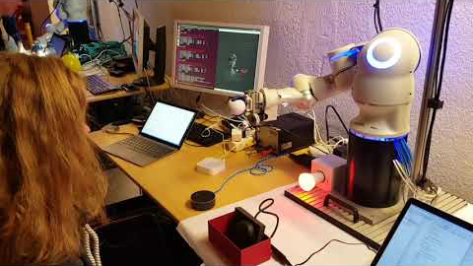

Slide 13
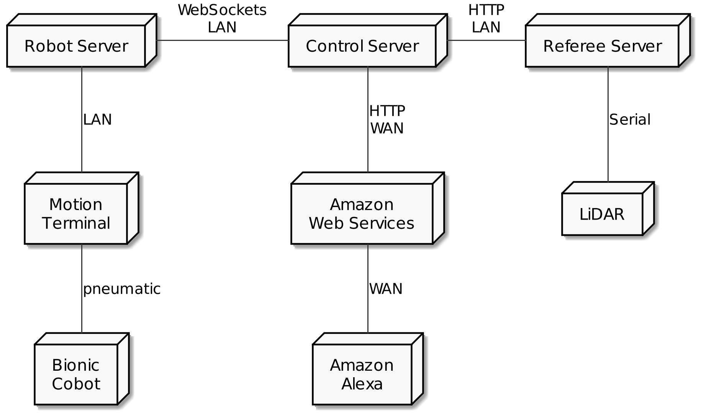






Notes:
So this is the architectural details of this solution
Control Server gets triggered by Amazon Alexa
Robot server controls Festo BionicCobot
Referee Server takes care that the rules of the game are obeyed

Slide 14
Festo BionicCobot
safe interaction due to flexible
air pressure operated joints
Intuitive interface
low-cost
incredibly lovely
Notes:
And this is the most impressive component of R.I.C
The Festo BionicCobot features flexible air pressure operated joints for safe interaction
it is intuitively operated
low-priced
And incredibly lovely!
This allows for a whole universe of human-machine interactions

Slide 15
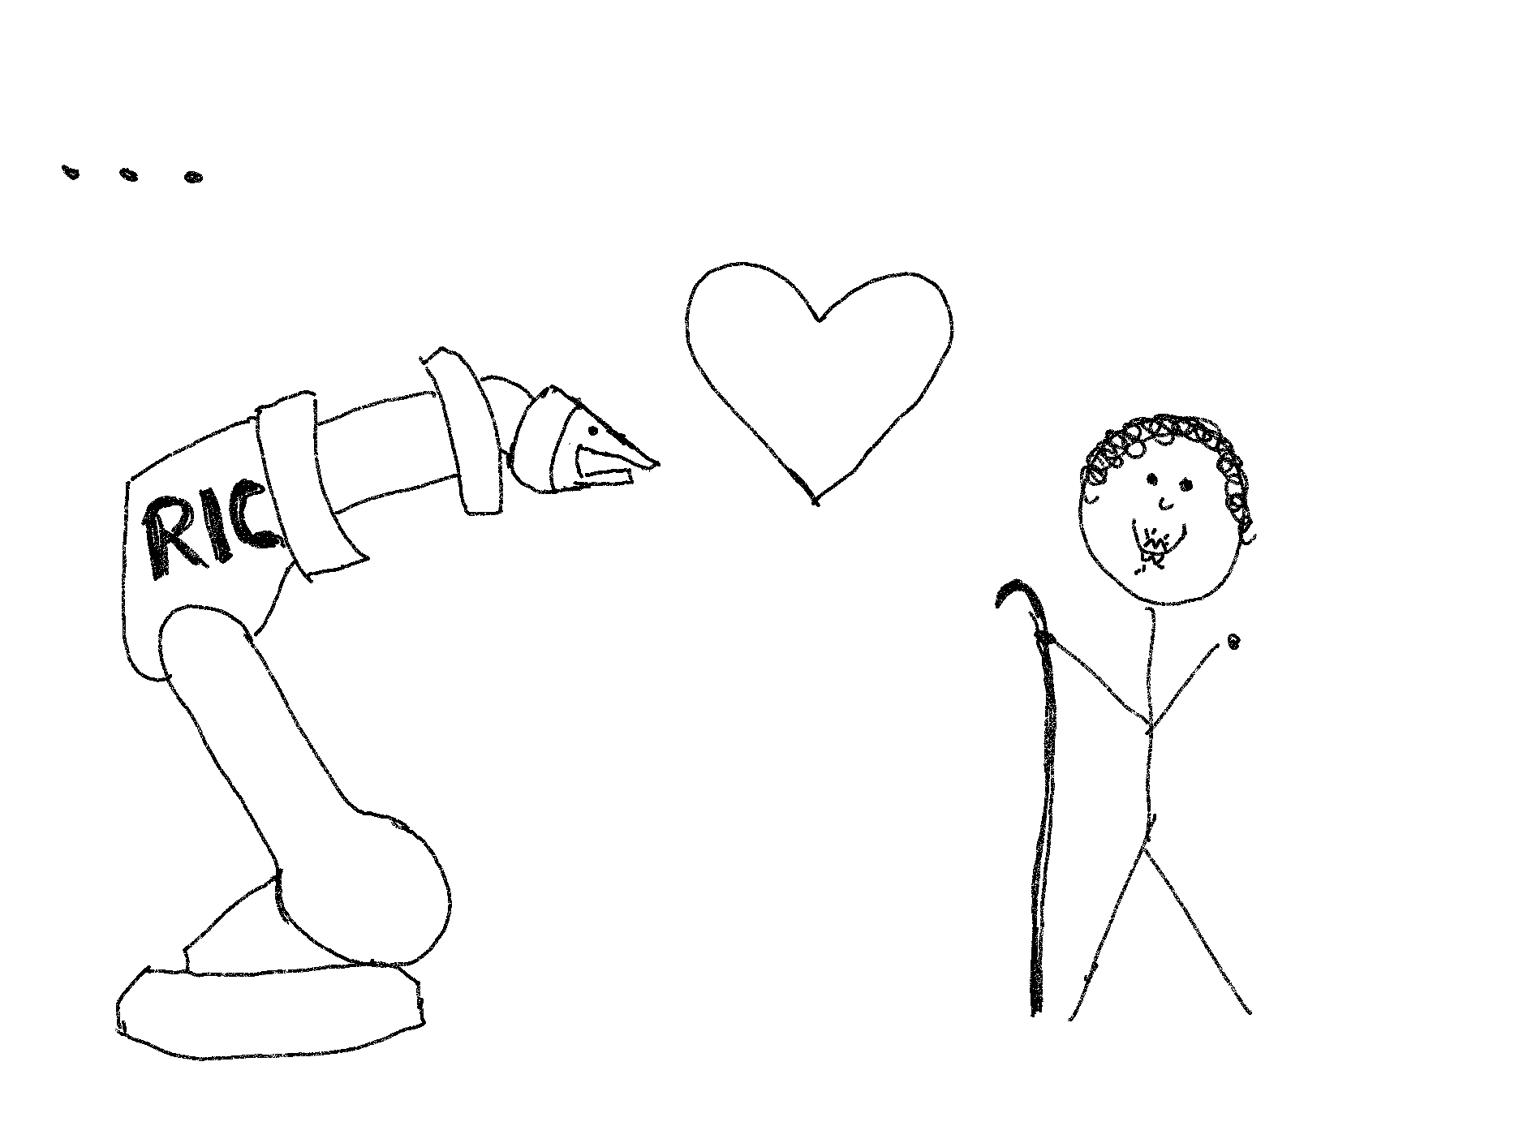


Notes:
And makes grandma happy :-)

Slide 16
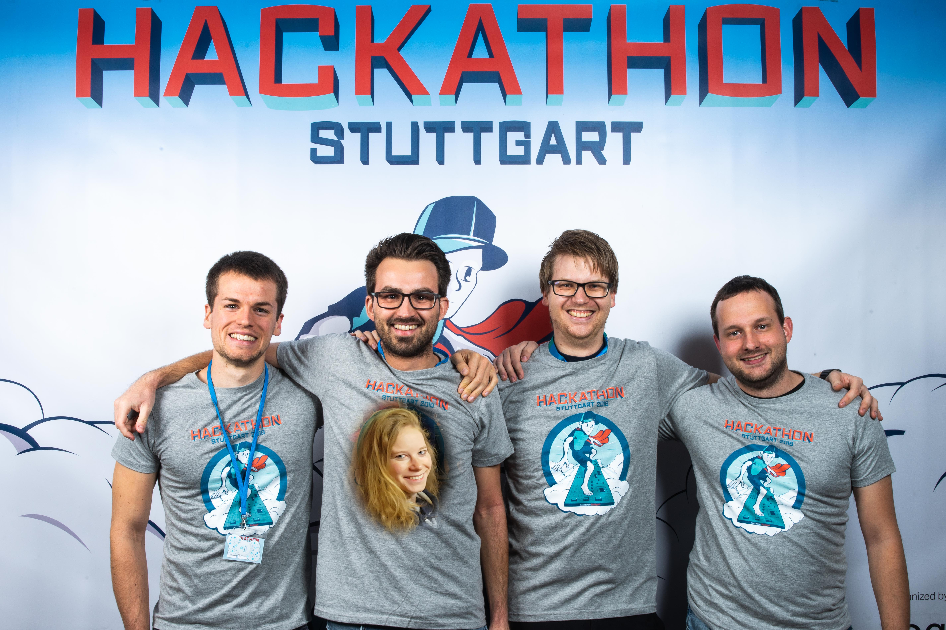
github.com/anoff/ric

